Slide 1
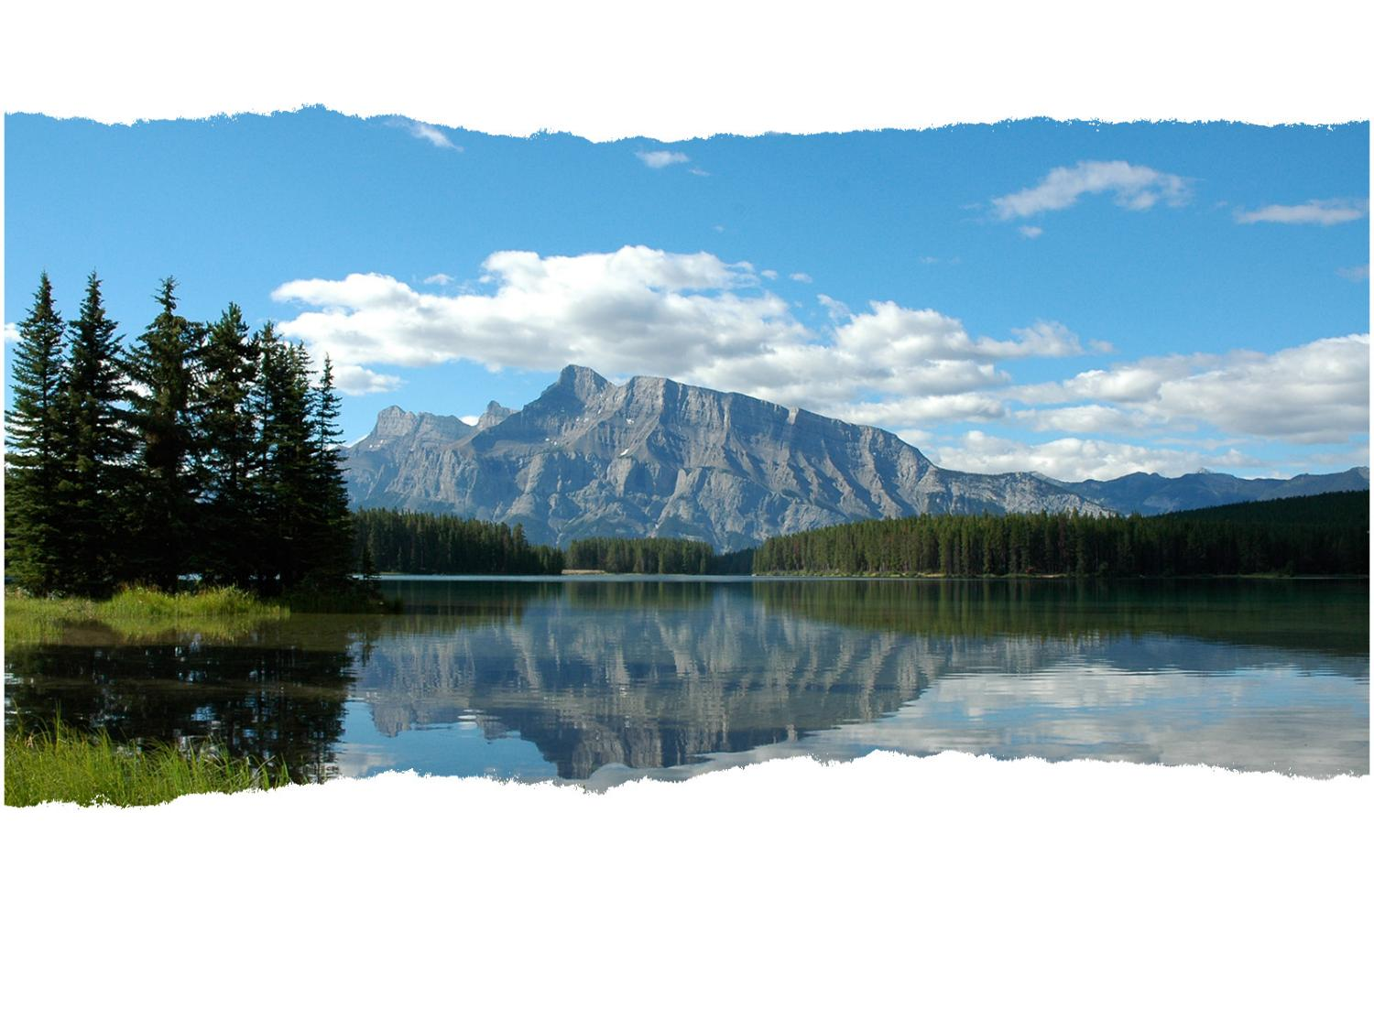
Carbon Cycle Activity
IB Biology
© David Faure, InThinking www.biology-inthinking.co.uk

Slide 2
Different types of Carbon
Carbon Dioxide Gas
Dissolved Carbon dioxide
Carbohydrates (e.g. glucose)
Hydrogen carbonate ions (CO₃⁻)
Methane gas
Peat – (organic C rich molecules)
Hydrocarbons in oil and gas
Corals and Molluscs
Limestone Rocks (Carbonates)

Slide 3
Reservoirs and Processes
Reservoirs
( places where carbon is stored)
Living Plants
Living Animals
Decomposer organisms
Soils and Organic molecules
Fossil Fuels
Sedimentary Rocks
Corals and Shellfish
Phytoplankton
Oceanic Food webs
Sea water
Processes
(ways of moving carbon from one reservoir to another)
Photosynthesis
Respiration
Decomposition
Diffusion
Combustion
Fossilization
Feeding
Erosion of rocks
Volcanic eruption

Slide 4
Carbon Cycle Diagram
Cut out these labels and stick them to the following diagram
Volcanoes
Living animals
Phytoplankton
Soils & Peat
Atmosphere
Ocean Food webs
Corals & shell-fish
Sea Water
Living plants
Decomposers
Fossil fuels
Sedimentary Rocks
Draw arrows labelled with these processes connecting the carbon reservoirs
Photosynthesis
Respiration
Decomposition
Diffusion
Combustion
Fossilization
Feeding
Erosion of rocks
Volcanic eruption

Slide 5
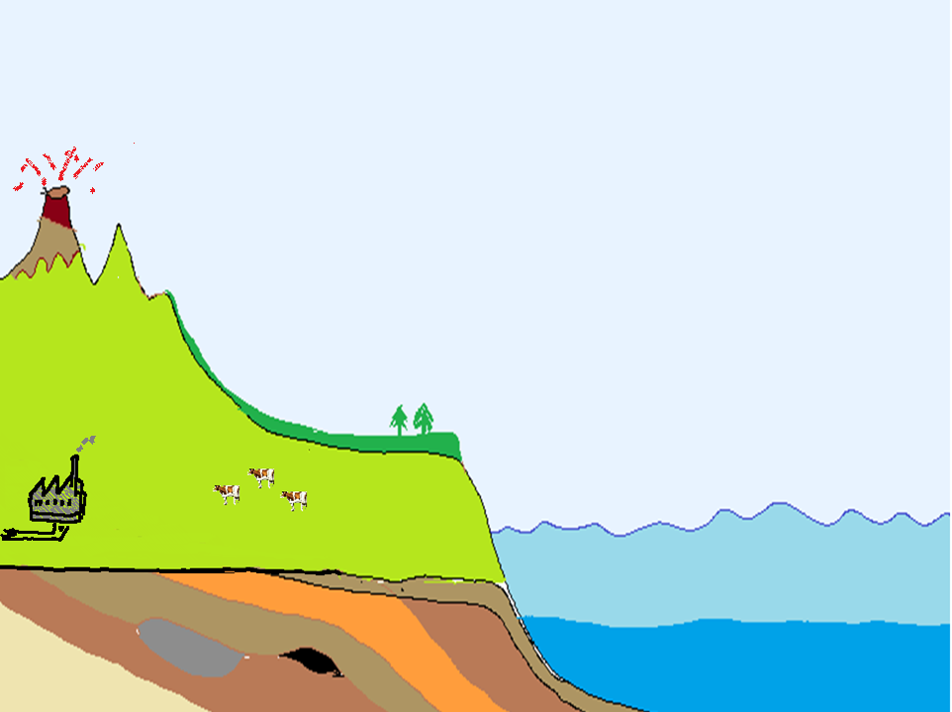
Carbon Cycle Diagram
Drag and drop the labels then draw on the arrows showing processes to complete the diagram
Ocean Food webs
Phytoplankton
Soils & Peat
Atmosphere
Volcanoes
Corals & shell-fish
Sea Water
Living plants
Living animals
Decomposers
Fossil fuels
Sedimentary Rocks

Slide 6
Carbon Cycle Diagram
Stick on the carbon reservoir labels then draw arrows showing processes to complete the diagram

Slide 7
Carbon Cycle Diagram
Volcanoes
Atmosphere
Living animals
Living plants
Decomposers
Soils & Peat
Phytoplankton
Sea Water
Fossil fuels
Corals & shell-fish
Ocean Food webs
Sedimentary Rocks

Slide 8
Carbon Cycle Diagram
Cut out these labels and stick them to the following diagram
Volcanoes
Living animals
Phytoplankton
Soils & Peat
Atmosphere
Ocean Food webs
Corals & shell-fish
Sea Water
Living plants
Decomposers
Fossil fuels
Sedimentary Rocks
Draw arrows labelled with these processes connecting the carbon reservoirs
Photosynthesis
Respiration
Decomposition
Diffusion
Combustion
Fossilization
Feeding
Erosion of rocks
Volcanic eruption

Slide 9
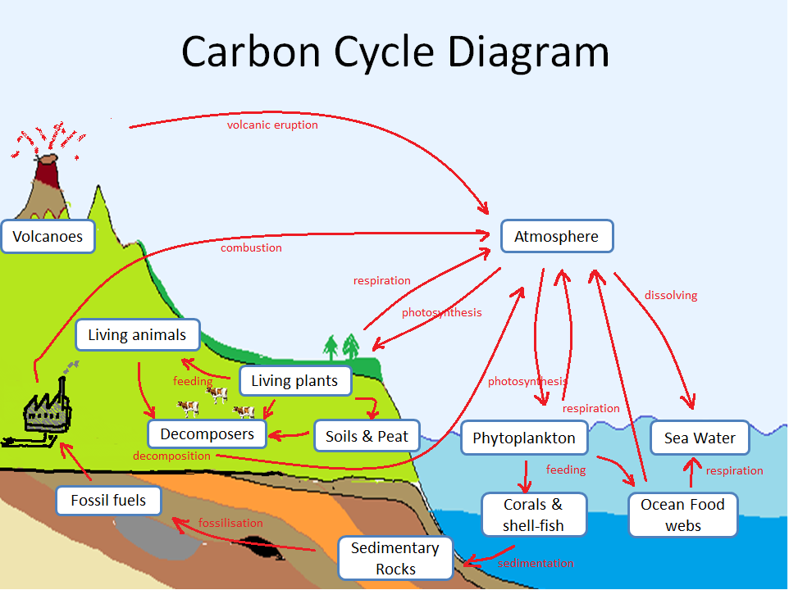
One possible solution

Slide 10
One possible solution

Slide 11
Questions
Name three processes that release carbon dioxide into the atmosphere.
Name three process which move carbon from one reservoir to another, apart from to and from the atmosphere.
Describe the movement of carbon that would happen very quickly (in days) between two or more reservoirs. Include the reservoirs, the processes and the forms of carbon.
Draw a diagram and describe the movement of carbon though two or more reservoirs that would store carbon for thousands or millions of years.
A Carbon Sink is a reservoir which absorbs more carbon than it releases. Suggest two possible carbon sinks.
Carbon Flux is the flow of carbon from one reservoir to another and its rate is measured in Gigatonnes of Carbon per year (GtC/yr). Suggest the process which has the greatest carbon flux.

Slide 12
Carbon cycle showing carbon flux and carbon reservoir sizes
Atmosphere
750 Gt
Photosynthesis 62Gt/yr
Terrestrial Biosphere
Plants & Animals
2000 Gt
Dissolving 90 Gt/yr
Oceanic Biosphere
39 000 Gt
Fossilization 0.3 Gt/yr
Lithosphere
Rocks and Magma
37 000 000 Gt
Volcanic eruptions 0.1 Gt/yr
Combustion 6Gt/yr
Respiration 60 Gt/yr
Release 92 Gt/yr

Slide 13
Questions
Outline the processes that release carbon dioxide into the atmosphere from the lithosphere (carbonate rocks).
Estimate the size of the Carbon Flux from the Biosphere to the Atmosphere which is caused by deforestation and the burning of wood. Give your answer in Gigatonnes of Carbon per year (GtC/yr) and explain how you made the estimate.

Slide 14
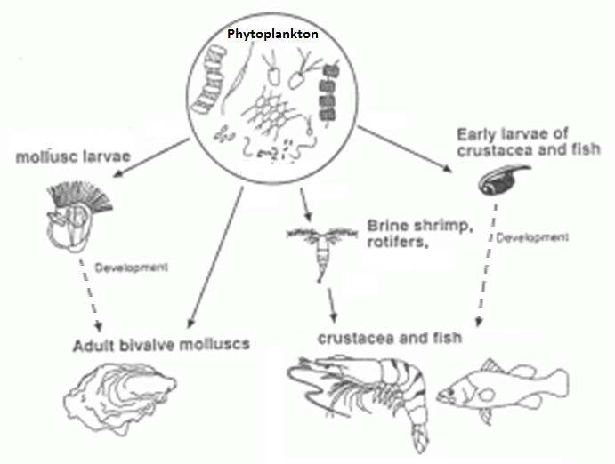
Carbon Cycle
A simple oceanic food web.
Crustaceans and Molluscs play an important role in the oceanic carbon sink.
Image courtesy of www.aquaculture.urgent.be.

Slide 15
Questions
Explain the two main physical / chemical processes by which carbon dioxide molecules in the air move to the cells of phytoplankton in the ocean.
A Carbon Sink is a reservoir which absorbs more carbon than it releases. Suggest how carbon in the bodies of crustaceans and molluscs is removed from the oceanic food chain to become part of another, slower carbon reservoir.

