Slide 1
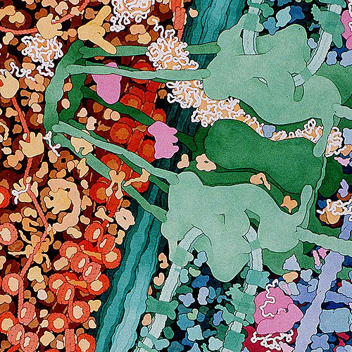
Historical Models of the Cell Membrane
All text comes from:
Membrane Function Part 1, by W.R. Healy, K.N. Prestwich, and J. Rymer. © 2010

Slide 2
What is a model?
Models are conceptual representations used to explain and predict phenomena.
Models can be quite useful when the subject under study (the membrane in this case) cannot be observed directly.

Slide 3
SCIENTIFIC MODELS are HYPOTHESIS THAT…
A. Explain observations
B. Predict future observations
C. Are realistic
#4

Slide 4
What is a model?
Models have limitations. No model can possibly explain every detail of a phenomena.

Slide 5
Early Observations of the Cell Membrane
Although it could not be observed under the light microscope, early cell biologists quickly grasped that something must exist that effectively separates the inside of the cell from its external environment.
They also realized that this structure would be more than a simple barrier since it obviously let some substances pass while it blocked others.
Moreover, the rate at which it let materials pass often varied over time.

Slide 6
Gorter and Grendel Model
Read what they did
Add drawings for the following boxes on a whiteboard that illustrate the observations and deduction
Add the information to your notes.
OBSERVATION
DEDUCTION

Slide 7
Gorter & Grendel’s Model
1925
Extracted phospholipids from the cell membrane of red blood cells
Calculated that the surface area of the phospholipids when arranged in a monolayer was twice as large as the surface area of the intact red blood cell.

Slide 8
Gorter & Grendel’s Model
What could Gorter and Grendel deduce about the cell membrane’s structure from this evidence?

Slide 9
Davson and Danielli Model
Read what they did
Add drawings for the following three boxes on a whiteboard that illustrate the observations and deduction
Add the information to your notes
OBSERVATION
DEDUCTION
ELECTRON MICROSCOPY SHOWED:
CONCLUDED THAT:

Slide 10
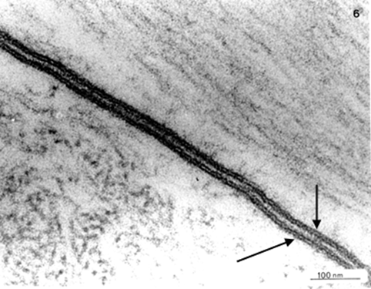
Davson and Danielli’s Model
Proteins show up dark under the electron microscope- with lipids showing up clear.
In the 1930’s, it was discovered that the cell membrane is made of both phospholipids AND proteins.
Using the newly invented electron microscope that allowed for greater magnification of the membrane, Davson and Danielli observed this →

Slide 11
Davson and Danielli’s Model
What could Davson and Danielli deduce about where proteins and lipids are found in the cell membrane based on this evidence?

Slide 12
Evidence Againsts the Davson & Danielli Model
The Davson-Danielli model of membrane structure was accepted by most cell biologists for about 30 years.
Results of many experiments fitted the model including X-ray diffraction studies and electron microscopy.
In the 1950s and 60s some experimental evidence accumulated that did not fit with the Davson-Danielli model.

Slide 13
Evidence Againsts the Davson & Danielli Model
Read about the problems
Add drawings for the following three boxes on a whiteboard that illustrate the technique used
Add the information to your notes
Freeze-etched micrographs
Structure of membrane proteins
Antibody tagging

Slide 14
Evidence Againsts the Davson & Danielli Model
Freeze-etched electron micrographs:
This technique involves rapid freezing of cells and then fracturing them. The fracture occurs along lines of weakness, including the center of membranes.
Globular structures scattered through freeze-etched images of the center of membranes were interpreted as transmembrane proteins.
How does this not fit with Davson & Danielli’s Model?

Slide 15
Evidence Againsts the Davson & Danielli Model
Structure of membrane proteins:
Improvements in biochemical techniques allowed proteins to be extracted from membranes.
The proteins were found to be very varied in size and globular in shape so were unlike the type of structural protein that would form continuous layers on the periphery of the membrane.
Continued

Slide 16
Evidence Againsts the Davson & Danielli Model
Structure of membrane proteins:
Also the proteins were hydrophobic on at least part of their surface so they would be attracted to the hydrocarbon tails of the phospholipids in the center of the membrane.
How does this not fit with Davson & Danielli’s Model?

Slide 17
Evidence Againsts the Davson & Danielli Model
Fluorescent antibody tagging:
Red or green fluorescent markers were attached to antibodies that bind to membrane proteins.
The membrane proteins of some cells were tagged with red markers and other cells with green markers.
The cells were fused together and within 40 minutes the red and green markers were mixed throughout the membrane of the fused cell.
How does this not fit with Davson & Danielli’s Model?

Slide 18
Singer and Nicolson Model
Read about them
Add drawings for the following two boxes on a whiteboard that illustrate the observations and deduction
Add the information to your notes
OBSERVATION
DEDUCTION

Slide 19
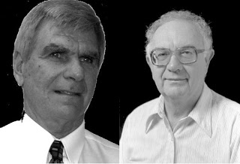
Singer & Nicolson’s Model
SJ Singer and GL Nicolson had further questions and doubts about Davson & Danielli’s model in 1972:
How could membranes vary in function if they all had the same structure?
How could lipid soluble material pass through membranes regardless of size if a protein cap protected the lipid?

Slide 20
Singer & Nicolson’s Model
As evidence mounted which undermined the accepted model of membrane structure, Singer & Nicholson proposed a new model that was more consistent with experimental data.
This model, called the fluid mosaic model, emphasized the dynamic nature of membranes in sharp contrast to the static Davson-Danielli model.

Slide 21
Singer & Nicolson’s Model
According to Singer and Nicolson:
the molecular structure of the membrane is not rigid and fixed, but rather flows - especially the bimolecular layer of lipids.
the lipids are not capped with a solid protein coating. Instead, proteins are dispersed throughout the membrane, leaving many portions of the lipid bare and exposed to the extra- and intracellular environments. It is through these bare areas that lipid-soluble molecules pass.

Slide 22
Singer & Nicolson’s Model
According to Singer and Nicolson:
In addition to being attached to both lipid surfaces (peripheral proteins), proteins are also embedded in the lipid matrix itself (integral proteins).

Slide 23
Singer & Nicolson’s Model
The Singer & Nicolson fluid mosaic model has been the leading model now for over 50 years.
It would be unwise to assume though that it will never be superseded.
There are already some suggested modifications of the model.

