Slide 1
Pangolin – worlds most hunted species
A critically endangered species – iucn redlist

Slide 2
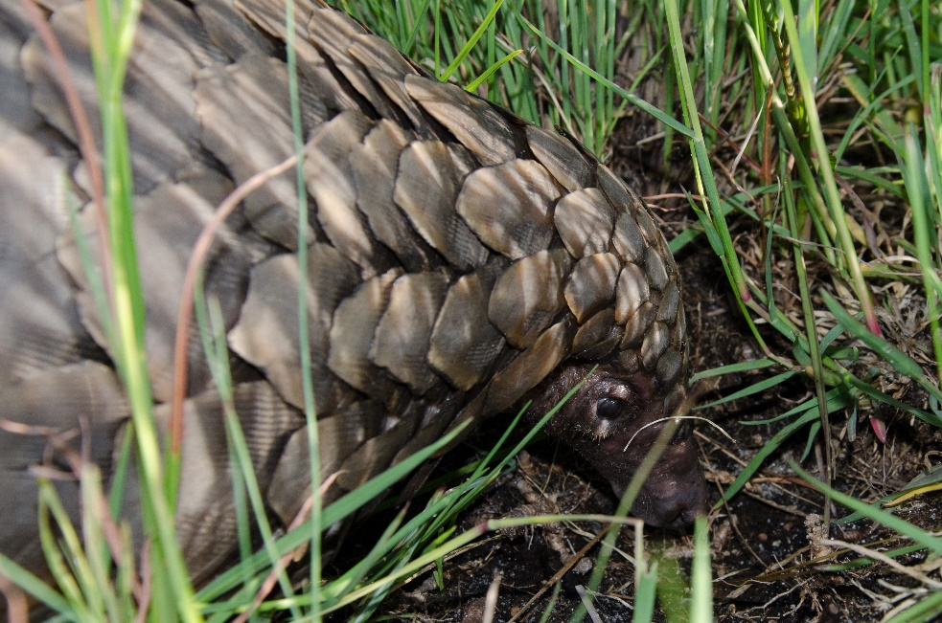
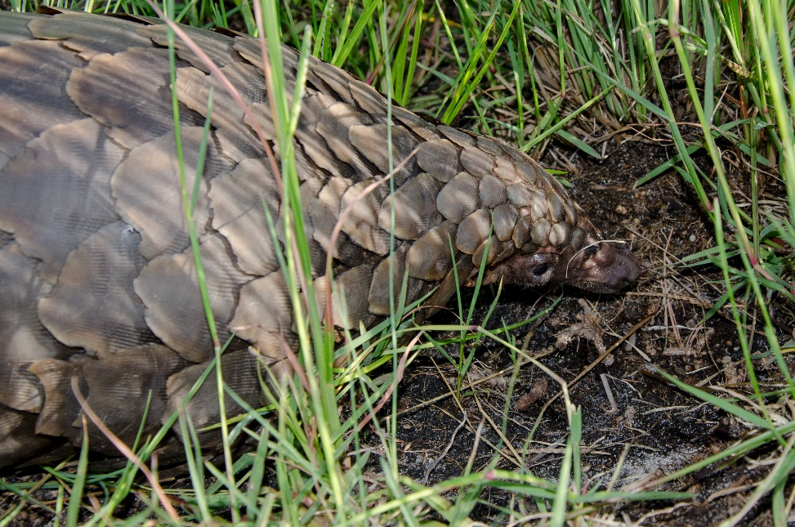
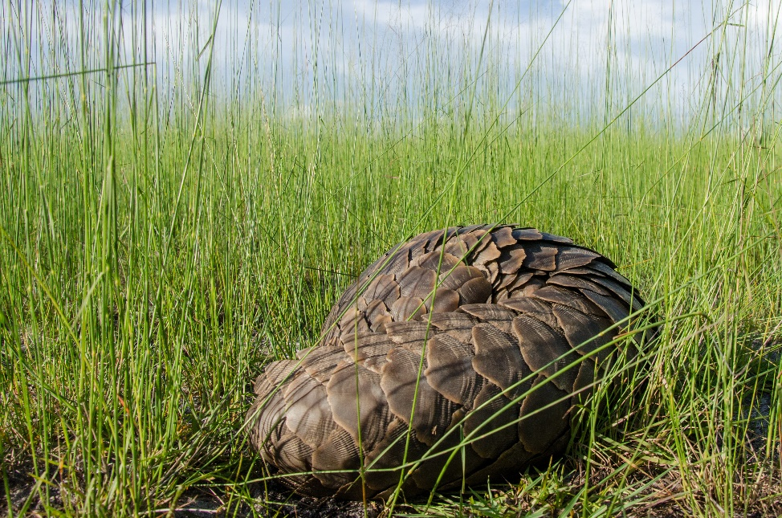
First watch this video….
http://wildaid.org/news/pangolins-movie
Photos taken by Kenny Babilon, Liuwa Plain National Park

Slide 3
A good news story
This is Mr Tembo, Senior Law Enforcement Officer at Liuwa Plain National Park, Zambia.
His unit received a tip off from a nearby village that a poacher was holding a live pangolin for purchase by nearby Chinese road workers.
The law enforcement team undertook a raid on the village and rescued this pangolin.
The pangolin proved to be a tough and resilient fellow and survived 5 days being carried around in a sack before he was released back into the park by Mr Tembo.

Slide 4
thylacine
A species now extinct

Slide 5
A relatively recent extinction
Known as the Tasmanian tiger, endemic to Australia, specifically Tasmania.
Believed to have become extinct around the 1960’s
All likely causes of extinction are man-made
The Thylacine was regarded as a threat to sheep and was hunted, trapped, and poisoned both for private and government bounties. In addition to these hunting pressures, habitat modification, increased competition from domestic dogs and disease may have all contributed to the demise of this species (Mooney and Rounsevell 2008).
There are some who say that there are still Tasmania tigers surviving, but this is considered urban myth

Slide 6
Improved conservation
Suggestions
African Elephant
American Grey Wolf
Whales
Attempt to change conservation status
Rhino
80 elephant are being removed to Australia as part of a type of Noah’s Ark programme
http://www.australiangeographic.com.au/news/2016/04/80-rhinos-headed-for-australia-in-bold-move-to-save-species

