Slide 1
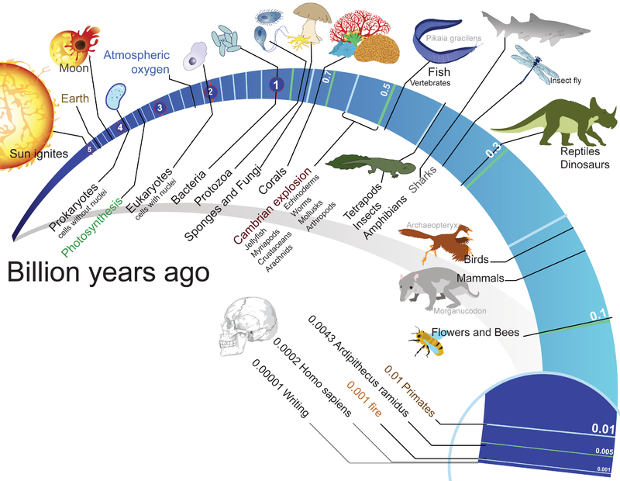

Slide 2
Four processes were needed for the spontaneous origin of life on early Earth:
Non-living synthesis of simple organic molecules

Slide 3
All of the elements found in organic compounds are thought to have existed on Earth and in the rest of the solar system when the Earth formed.
But how and where were these elements assembled into the organic compounds found in life?

Slide 4
What was early Earth like?
(Through the Wormhole video clip #1)

Slide 5
About 4.6 billion years ago the planets of our solar system formed by the condensing of matter around our sun
Notes:
Our solar system was filled with hot gases and dust, which swirled and revolved around a white hot core. When the core approached one million degrees Fahrenheit, our sun was born. The gaseous dust clouds gradually condensed and formed asteroids. It is estimated that over 100 trillion planetesimals, or large asteroids, existed when our solar system was formed. As these huge pieces of matter were revolving around the sun, many of them collided with one another. While some of these collisions destroyed the planetesimals, others caused them to combine. As their mass increased, gravity pulled in more particles and debris, and the planetesimals grew larger. This process, called accretion, is how the earth and the other planets were formed.

Slide 6
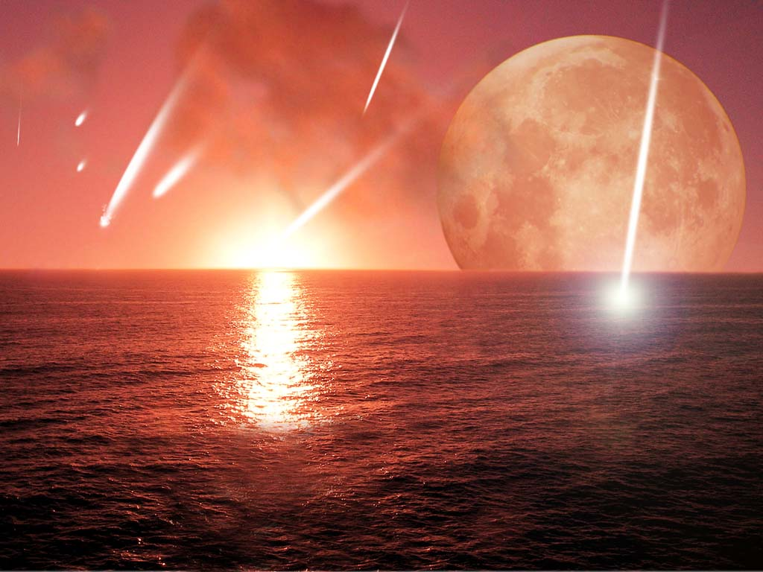
The Surface
Bombardment by meteorites.
Water vapor condensed to liquid, forming oceans.
Notes:
As the planet earth continued to be hit by meteorites, cosmic H2O was released from the meteorites and from the crust of the earth. This gaseous H2O rose into the atmosphere, combined with CO2 and other gases, and formed incredibly dense clouds above the earth. These clouds formed a reflective shield above the earth, keeping solar heat from penetrating to the surface. As the frequency of meteorite impacts declined, the surface of the earth began to cool. When this happened, the immense clouds which had emerged began to pour rain over the entire planet, cooling the molten rock, and creating lakes and oceans.

Slide 7
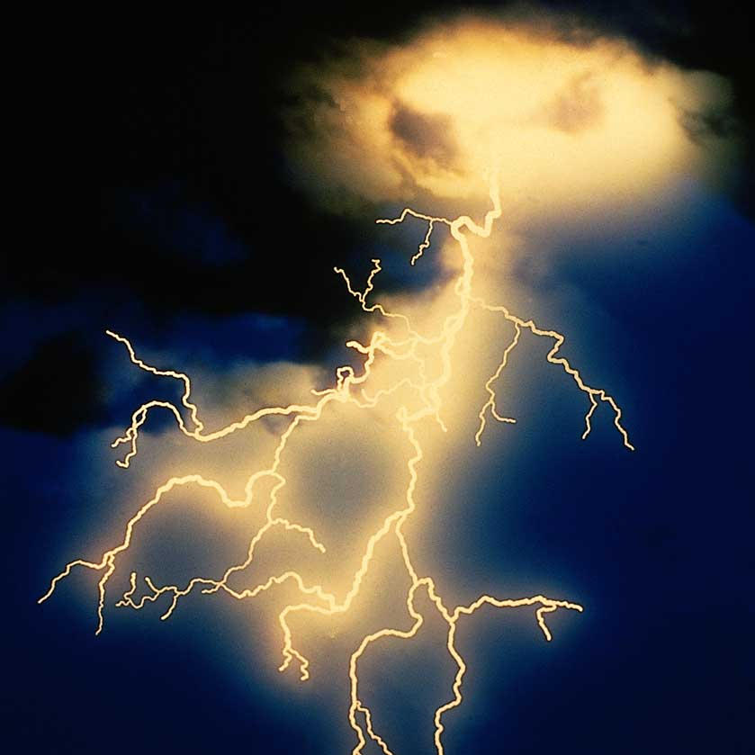
There were frequent lightening / electrical storms

Slide 8
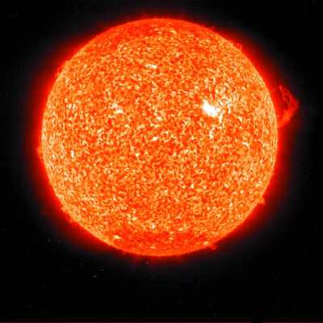
The Temperatures were high
(little atmosphere to shield heat from the sun)

Slide 9
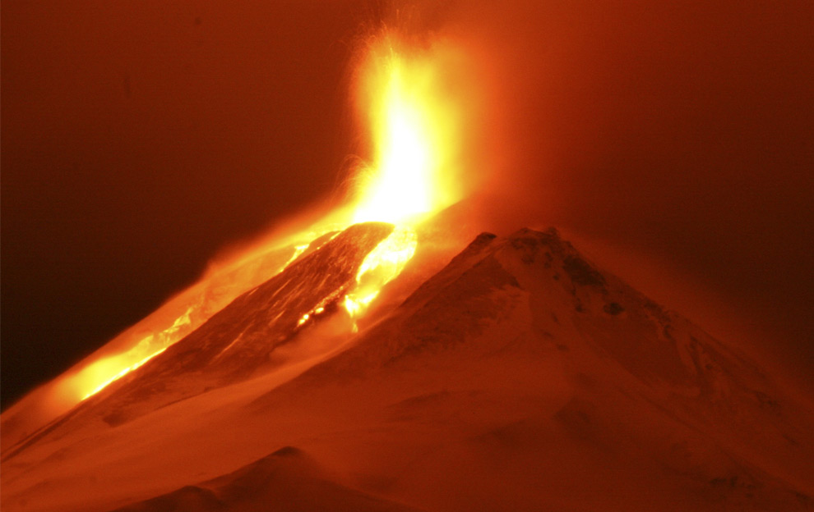
The Atmosphere
Earth’s primitive atmosphere formed by volcanic out gassing.
Notes:
Radioactive decay caused Earth’s core to heat and gases to build up in the earth's core. This caused huge volcanoes to spew forth molten rock, or lava, as well as various gases which had been trapped under the surface of the earth.

Slide 10
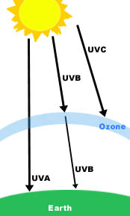
The Atmosphere: Then vs. Now
THEN:
UV light penetrated Earth’s atmosphere
NOW:
UV is absorbed by ozone in the atmosphere

Slide 11
The Atmosphere: Then vs. Now
Uncertainty remains
THEN (?):
Consisted of:
Methane
Ammonia
Water vapor
Nitrogen gas
Carbon dioxide
Hydrogen gas
Carbon monoxide
NOW:
Consists of:
Nitrogen gas (N₂)
Oxygen gas (O₂)
Notes:
Based on today's volcanic evidence, this atmosphere would have contained 80% water vapor, 10% carbon dioxide, 5 to 7% hydrogen sulfide, and smaller amounts of nitrogen, carbon monoxide, hydrogen, methane and inert gases

Slide 12
The Atmosphere: Then vs. Now
THEN (?):
Reducing
atmosphere:
lack of O₂ allows formation of complex organic molecules
NOW:
Oxidizing
atmosphere:
free O₂ inhibits formation of complex organic molecules
Oparin’s Hypothesis (1923)

Slide 13
Uncertainty
Growing evidence suggests that the early atmosphere was made up primarily of nitrogen and carbon dioxide and was neither reducing nor oxidizing.

Slide 14
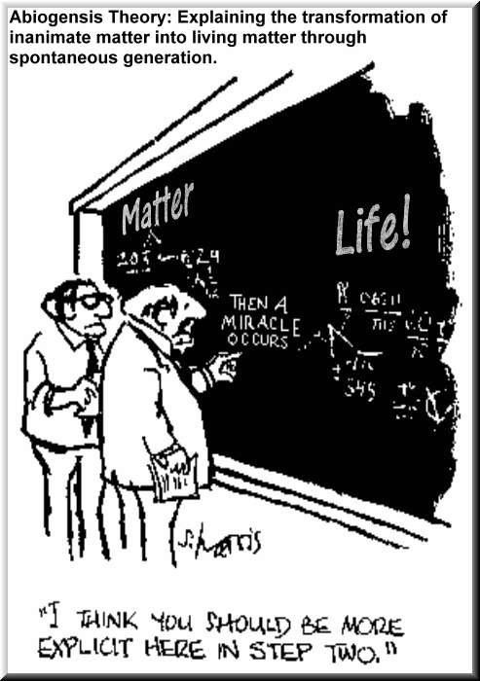
Two testable hypothesized mechanisms for the presence of simple organic molecules on Earth:
Organic molecules were created from inorganic matter on Earth
Organic molecules were delivered to Earth from outer space

Slide 15
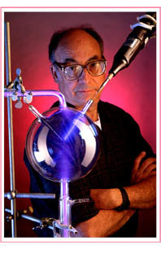
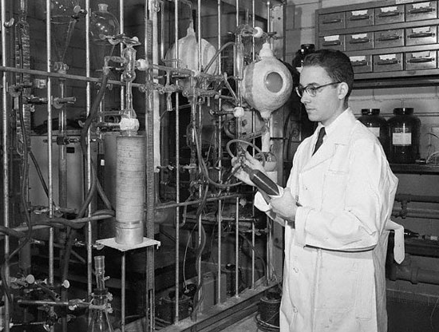
Miller and Urey (1953) duplicated Oparin’s early Earth conditions in the lab

Slide 16
Methods:
In a glass refluxing system, they recreated a miniature ocean-atmosphere system

Slide 17
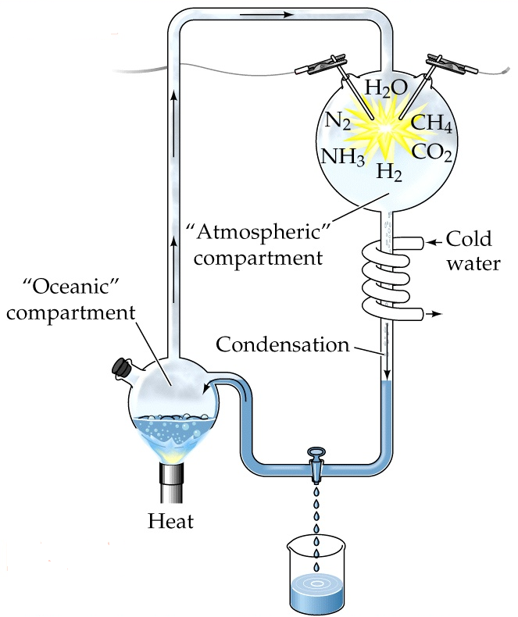
They included hydrogen, methane, ammonia and water into the system to model Oparin’s hypothesized pre-biotic atmosphere.
Notes:
The gases they used were methane (CH4), ammonia (NH3), hydrogen (H2), and water (H2O). He ran a continuous electric current through the system, to simulate lightning storms believed to be common on the early earth.

Slide 18
The mixture was heated and circulated past an electric spark (to model lightening) before allowing it to condense

Slide 19
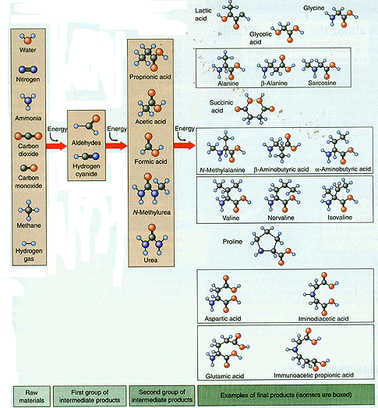
Amino acids were formed from the inorganic compounds
ANIMATION
Notes:
Analysis of the experiment was done by chromatography. At the end of one week, Miller observed that as much as 10-15% of the carbon was now in the form of organic compounds. Two percent of the carbon had formed some of the amino acids which are used to make proteins.

Slide 20
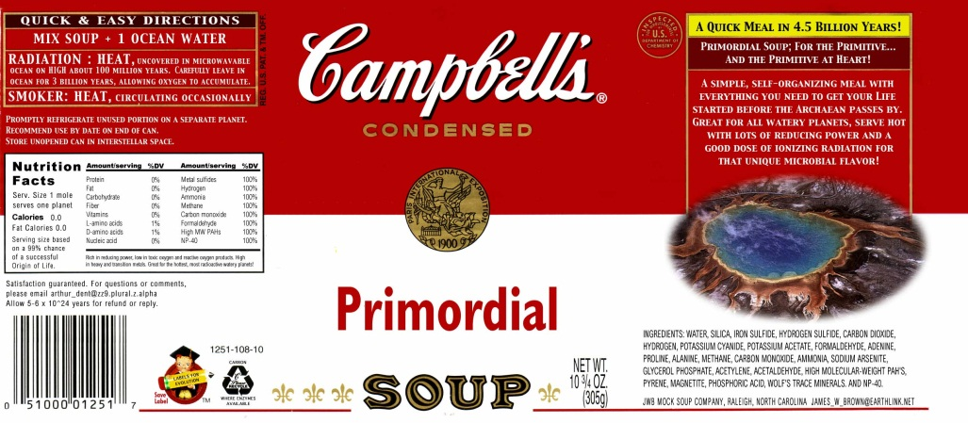
Other scientists repeated Miller and Urey’s work, eventually producing:
Other amino acids
ATP
Glucose and other sugars
Lipids
Bases which form RNA and DNA
Adenine (the key component of ATP)
These molecules would accumulate over long time periods producing thick, warm "primordial soup“
Notes:
In 1961, Juan Oro found that amino acids could be made from hydrogen cyanide (HCN) and ammonia in an aqueous solution. He also found that his experiment produced an amazing amount of the nucleotide base, adenine. Adenine is of tremendous biological significance as an organic compound because it is one of the four bases in RNA and DNA. It is also a component of adenosine triphosphate, or ATP, which is a major energy releasing molecule in cells. Experiments conducted later showed that the other RNA and DNA bases could be obtained through simulated prebiotic chemistry with a reducing atmosphere.

Slide 21
Conclusion: molecules of life can arise from non-living material TOK: we may be able to show that organic compounds could arise under certain conditions, but we can't determine with certainty whether they did in the past
Notes:
Perhaps most importantly, Miller's experiment showed that organic compounds such as amino acids, which are essential to cellular life, could be made easily under the conditions that scientists believed to be present on the early earth. This enormous finding inspired a multitude of further experiments.
There has been a recent wave of skepticism concerning Miller's experiment because it is now believed that the early earth's atmosphere did not contain predominantly reductant molecules. Another objection is that this experiment required a tremendous amount of energy. While it is believed lightning storms were extremely common on the primitive Earth, they were not continuous as the Miller/Urey experiment portrayed. Thus it has been argued that while amino acids and other organic compounds may have been formed, they would not have been formed in the amounts which this experiment produced.
Instead of forming in the atmosphere, the first organic compounds on Earth may have been synthesized near submerged volcanoes and deep–sea vents—weak points in Earth’s crust where hot water and minerals gush into the ocean.

Slide 22
Two testable hypothesized mechanisms for the presence of simple organic molecules on Earth:
Organic molecules were created from inorganic matter on Earth
Organic molecules were delivered to Earth from outer space

Slide 23
Extraterrestrial Hypothesis
Comets contain a variety of organic compounds.
Heavy bombardment 4,000 million years ago may have delivered both organic compounds and water to the early Earth.
Notes:
Analysis of light spectra of comets

Slide 24
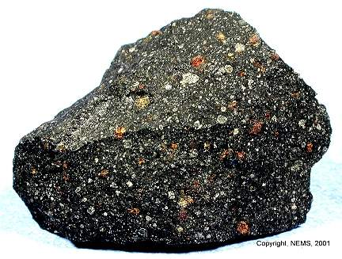
Example:
Murchison Meteorite
Rich with amino acids
Demonstrates that Earth may have acquired organic compounds from space
Notes:
Many of the compounds made in the Miller/Urey experiment are known to exist in outer space. On September 28, 1969, a meteorite fell over Murchison, Australia. While only 100 kilograms were recovered, analysis of the meteorite has shown that it is rich with amino acids. Over 90 amino acids have been identified by researchers to date. Nineteen of these amino acids are found on Earth. (table showing comparison of Murchison meteorite to Miller/Urey experiment) The early Earth is believed to be similar to many of the asteroids and comets still roaming the galaxy. If amino acids are able to survive in outer space under extreme conditions, then this might suggest that amino acids were present when the Earth was formed. More importantly, the Murchison meteorite has demonstrated that the Earth may have acquired some of its amino acids and other organic compounds by planetary infall.

Slide 25
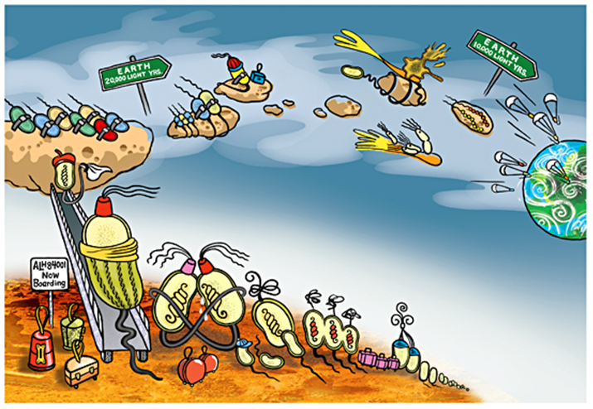
Notes:
A wilder offshoot of this theory, suggests that whole bacteria—life itself—first evolved on Mars and then hitched a ride to Earth via small pieces of the Red Planet blasted here by asteroid or comet impacts. But no life has been found on Mars, and the one claim of fossil bacteria in a Martian meteorite, made by NASA scientists in 1996, has been almost universally rejected.

