Slide 1
Osmolarity in the real world

Slide 2
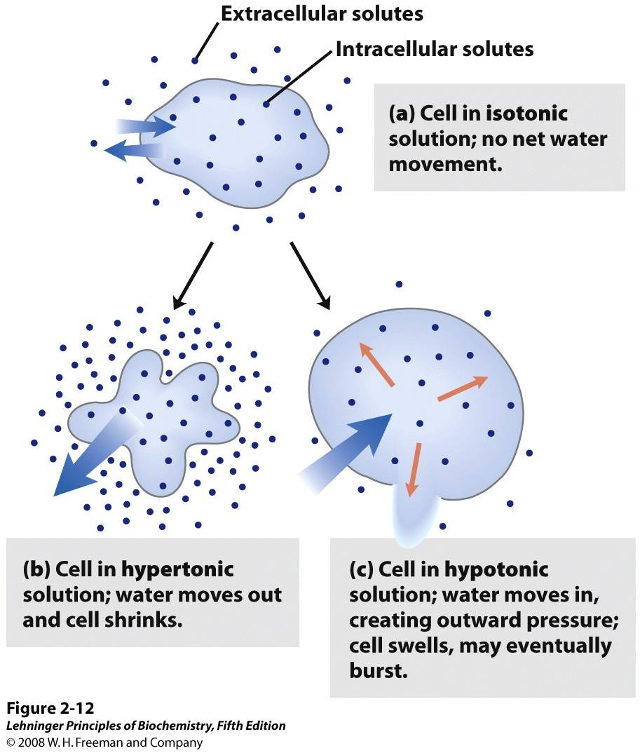
Osmolarity: the concentration of a solution expressed as the total number of solute particles per liter.

Slide 3
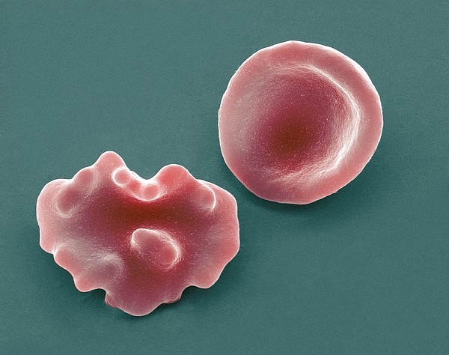
Hypertonic:
(hyper)= more
(tonic)= solute
A solution with an osmolarity that is hypertonic will have a higher concentration of solute (and conversely less water) than inside the cell.
This causes water through osmosis to leave the cell.
Animal cells placed in hypertonic solutions will undergo crenation (cell shrinking).

Slide 4
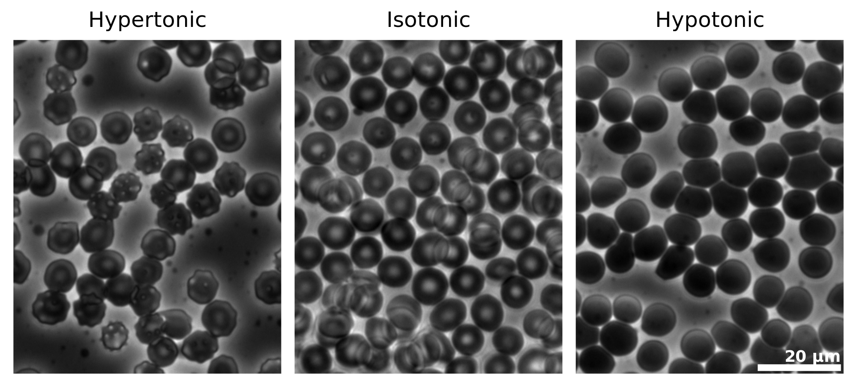
Hypotonic:
(hypo)= less
(tonic)= solute
A solution with an osmolarity that is hypotonic will have a lower concentration of solute (and conversely more water) than inside the cell.
This causes water through osmosis to enter the cell.
Animal cells placed in hypotonic solutions will undergo cytolysis (cell swelling)

Slide 5
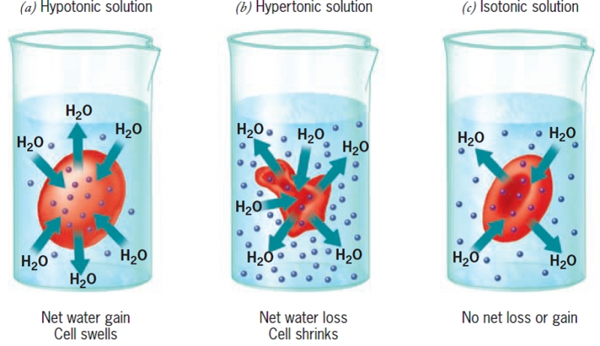
Isotonic:
(iso)= equal
(tonic)= solute
A solution with an osmolarity that is isotonic will have an equal concentration of solute (and an equal amount of water) as inside the cell.
This causes water through osmosis to enter and leave the cell at the same rate (no net movement).
Animal cells placed in isotonic solutions will behave normally.

Slide 6
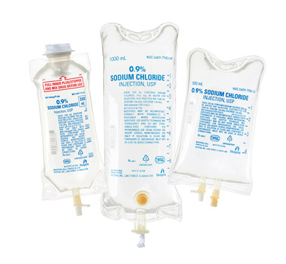
This is why saline is given to patients in the hospital rather than pure water.
Organs being transported for transplants are also covered in saline for the same purpose.
Based on the saline drips above, what is the osmolarity of human tissues?

Slide 7
What organ do you think is most responsible for maintaining our normal osmolarity?

Slide 8
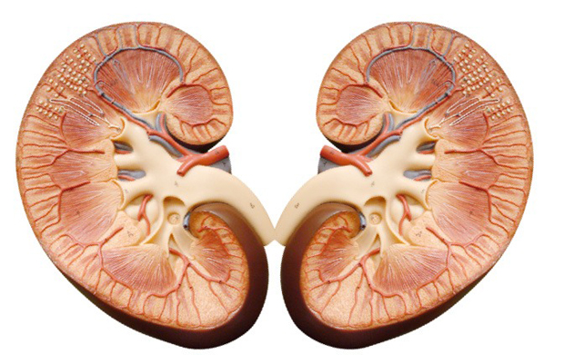
Why the Kidneys of course!
(more on this later)

